Slide 1

Database Systems: Design, Implementation, and Management
Chapter 4
Entity Relationship (ER) Modeling

Slide 2
The Entity Relationship Model (ERM)
ER model forms the basis of an ER diagram
ERDs depict database’s main components:
Entities
Attributes
Relationships

Slide 3
Entities
Refers to entity set and not to single entity occurrence
Corresponds to table and not to row in relational environment
In Chen and Crow’s Foot models, entity is represented by rectangle with entity’s name
Entity name, a noun, written in capital letters

Slide 4
Attributes
Characteristics of entities
Chen notation: attributes represented by ovals connected to entity rectangle with a line
Each oval contains the name of attribute it represents
Crow’s Foot notation: attributes written in attribute box below entity rectangle

Slide 5
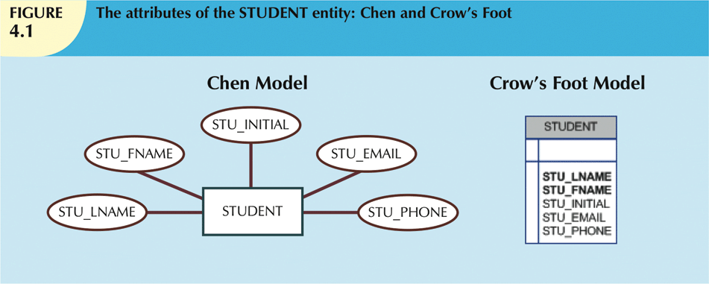
The Representation of Attributes in Chen and Crow’s Foot

Slide 6
Attributes (cont’d.)
Required attribute: must have a value
Optional attribute: may be left empty
Domain: set of possible values for an attribute
Attributes may share a domain
Primary Keys
One or more attributes that uniquely identify each entity instance – may be single or composite

Slide 7
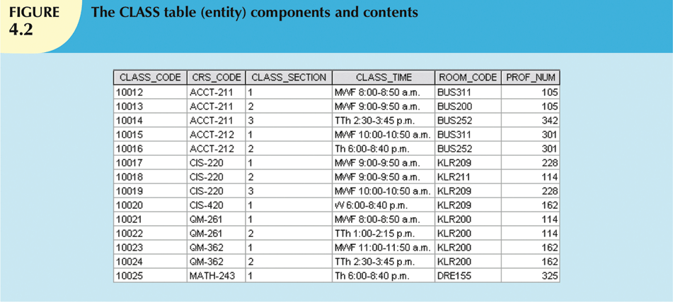

Slide 8
Attributes (cont’d.)
Composite attribute can be subdivided
Simple attribute cannot be subdivided
Single-value attribute can have only a single value (e.g. Color attribute:‘red’)
Multivalued attributes can have many values (e.g. Color attribute:‘red/white’)

Slide 9
Attributes (cont’d.)
Multivalued attributes should not be implemented
Create several new attributes for each of the original multivalued attributes’ components
(e.g. Color1 and color2)
Derived attribute: value may be calculated from other attributes
Need not be physically stored within database

Slide 10
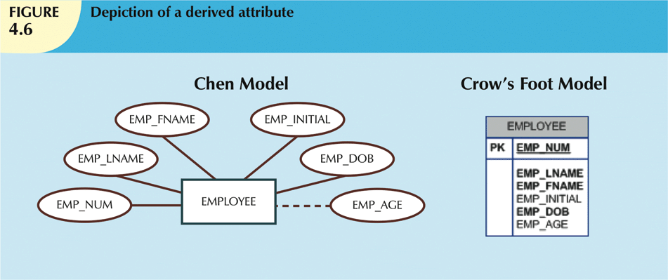
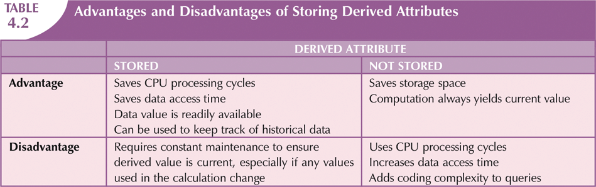

Slide 11
Relationships
Association between entities
Participants are entities that participate in a relationship
Relationships between entities always operate in both directions
Relationship can be classified as 1:M
Relationship classification is difficult to establish if only one side of the relationship is known

Slide 12
Connectivity and Cardinality
Connectivity
Describes the relationship classification
Cardinality
Expresses minimum and maximum number of entity occurrences associated with one occurrence of related entity
Established by very concise statements known as business rules

Slide 13
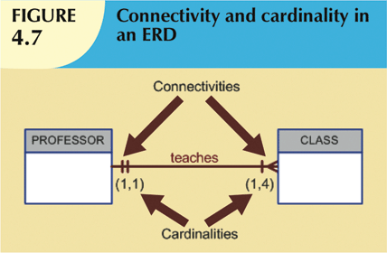

Slide 14
Existence Dependence
Existence dependence
Entity exists in database only when it is associated with another related entity occurrence
Existence independence
Entity can exist apart from one or more related entities
Sometimes such an entity is referred to as a strong or regular entity

Slide 15
Relationship Strength
Weak (non-identifying) relationships
Exists if PK of related entity does not contain PK component of parent entity
Strong (identifying) relationships
Exists when PK of related entity contains PK component of parent entity

Slide 16
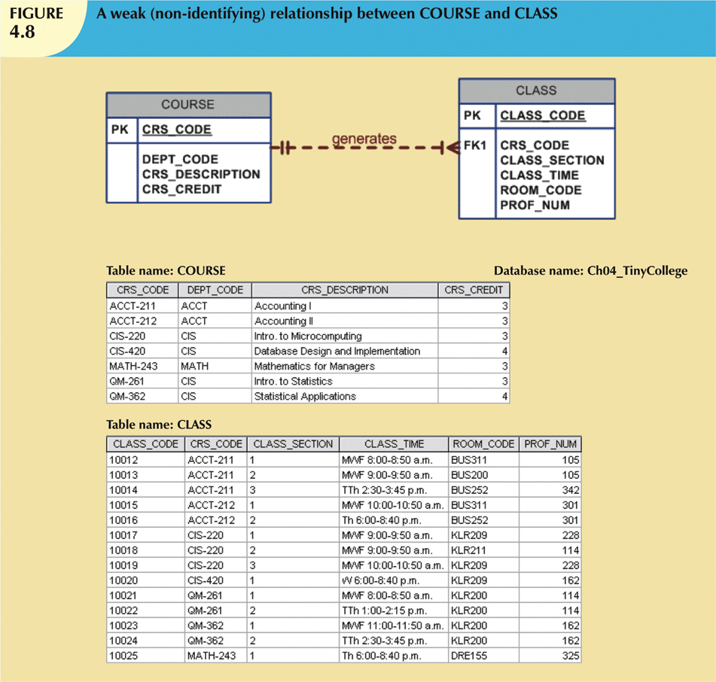
The Primary Key of the Class entity does not contain a component of the Primary key of the Course entity – WEAK RELATIONSHIP

Slide 17
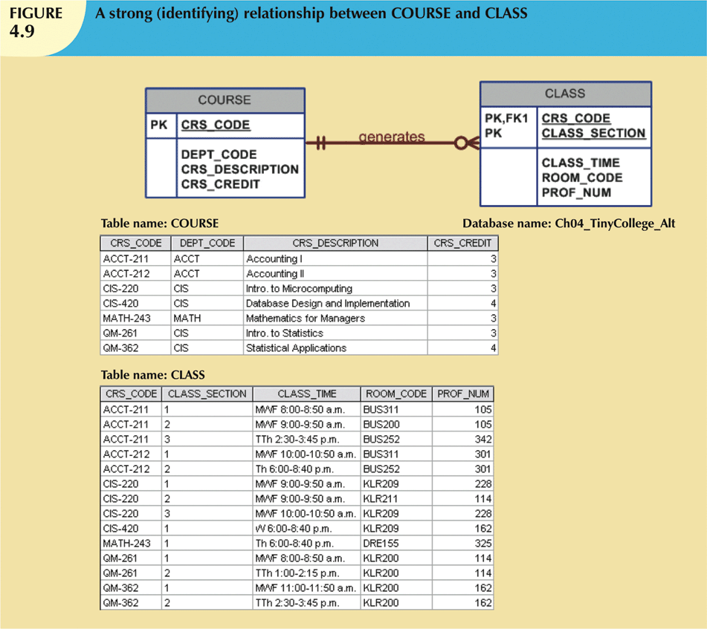
The Primary Key of the Class entity contains a component (CRS_CODE) of the Primary key of the Course entity – STRONG RELATIONSHIP

Slide 18
Weak Entities
ENTITY STRENGTH
Weak entity meets two conditions
Existence-dependent (Needs another)
Primary key partially or totally derived from parent entity in relationship
Database designer determines whether an entity is weak based on business rules
Do not confuse Relationship Strength with Entity strength

Slide 19
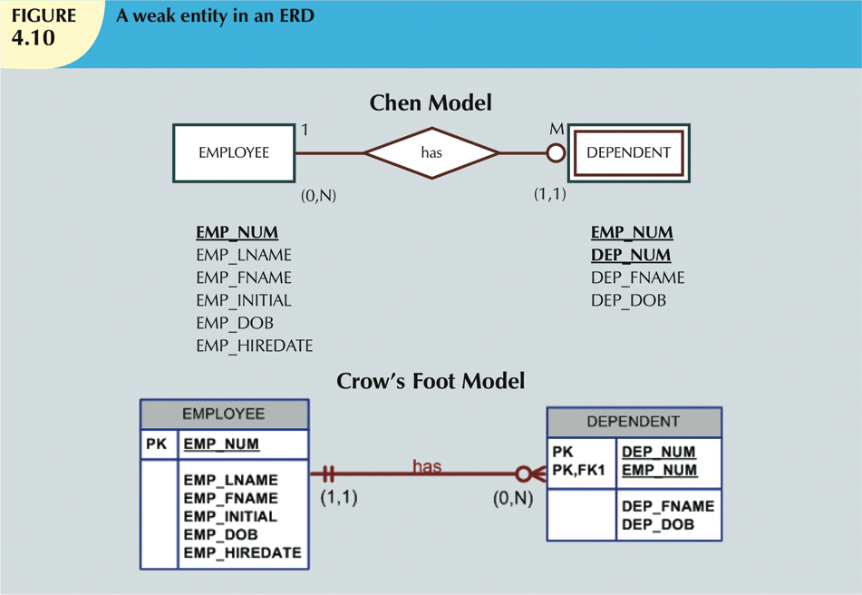
A ROW IN THE DEPENDENT ENTITY NEEDS A CORRESPONDING ROW IN THE EMPLOYEE ENTITY OF THE SAME EMP_NUM IN ORDER FOR IT TO EXIST

Slide 20
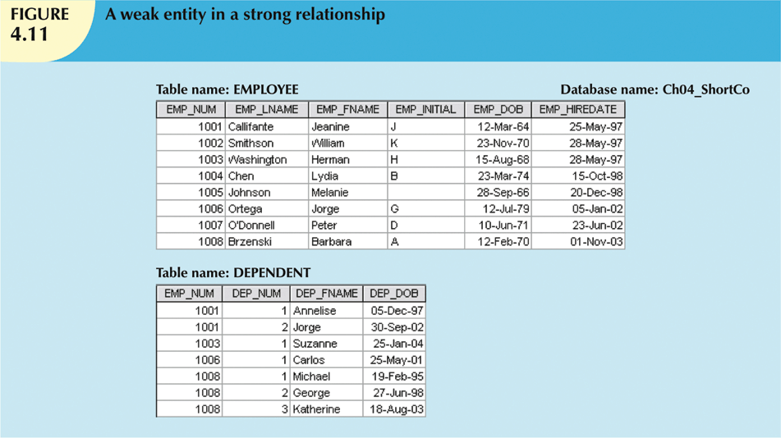
The dependent ENTITY is WEAK and its relationship with the EMPLOYEE entity is STRONG

Slide 21
Relationship Participation
Optional participation
One entity occurrence does not require corresponding entity occurrence in particular relationship
Mandatory participation
One entity occurrence requires corresponding entity occurrence in particular relationship

Slide 22
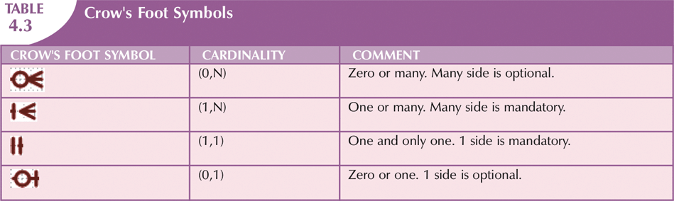

Slide 23
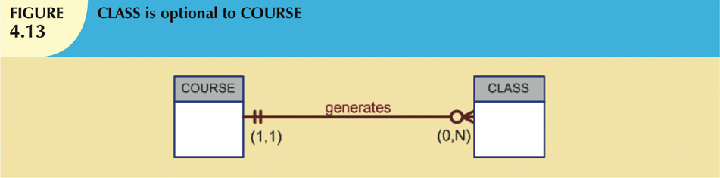

On the Many Side: 0 indicates optional participation and I indicates mandatory participation.

Slide 24
Relationship Degree
Indicates number of entities or participants associated with a relationship
Unary relationship
Association is maintained within single entity
Binary relationship
Two entities are associated
Ternary relationship
Three entities are associated

Slide 25
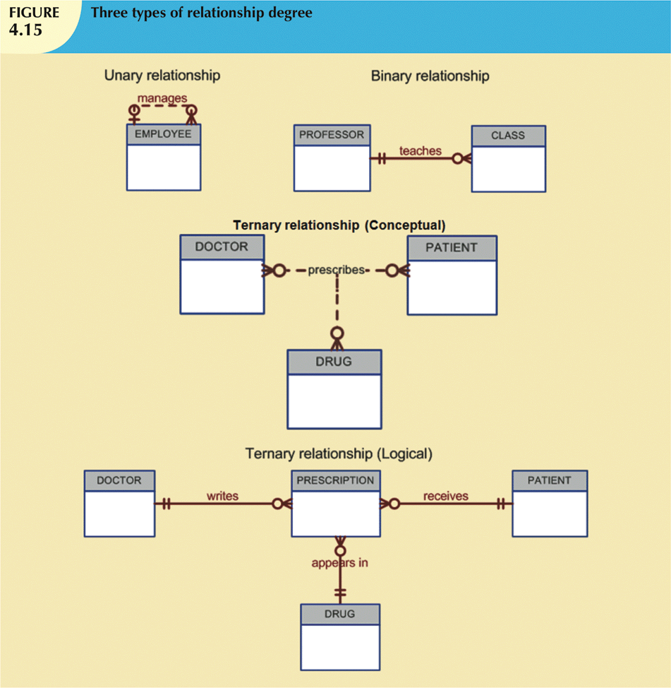

Slide 26
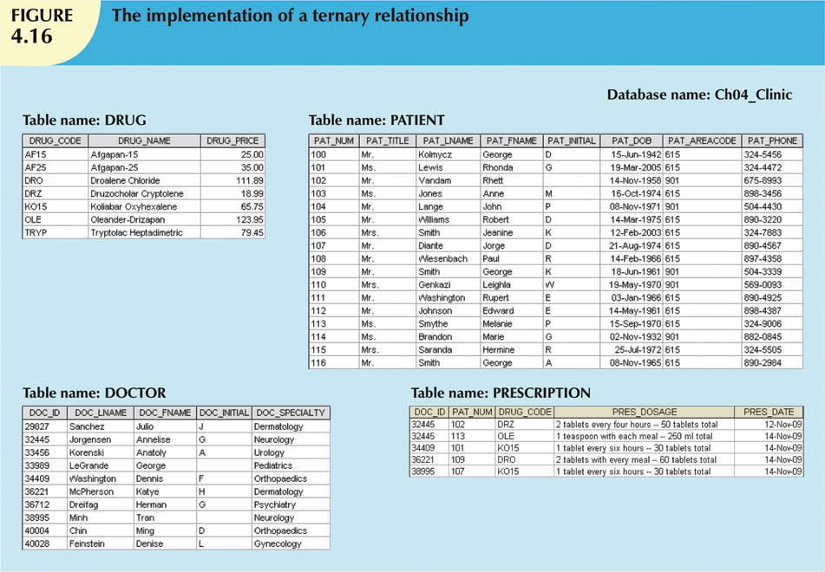
DOC_ID is PK in DOCTOR Entity, PAT_NUM is PK in PATIENT Entity ,DRUG_CODE is PK in DRUG Entity DOC_ID+PAT_NUM+DRUG_CODE collectively form the PK of the PRESCRIPTION Entity (Composite PK)
Each of the 3 component PK elements is also an FK since each each exists as a PK in the related tables
(Each prescription entity occurrence is uniquely identified by a combination of 3 attributes)

Slide 27
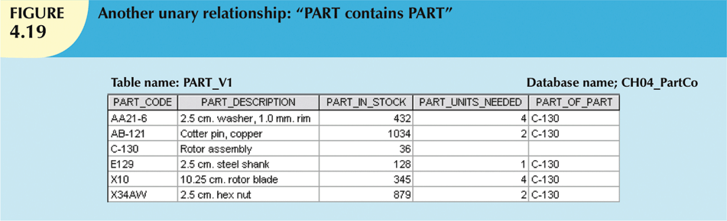
Recursive Relationships
Relationship can exist between occurrences of the same entity set
Naturally found within unary relationship

Slide 28
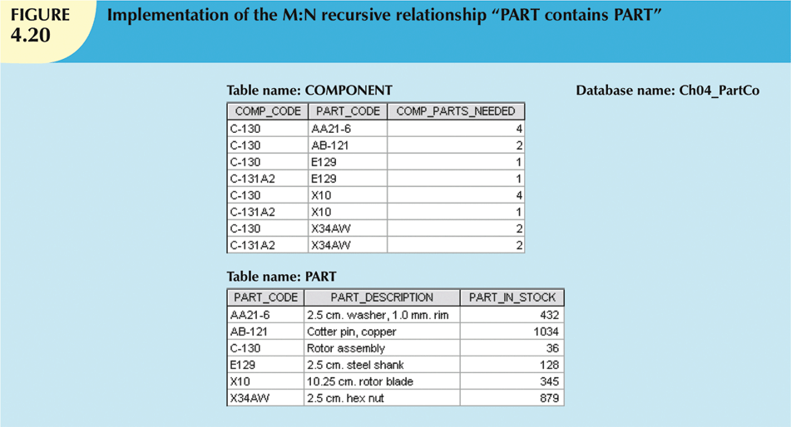
COMPONENT Entity has 2 attributes, both of which are taken from the PK of the PART Entity - Recursive relationship.

Slide 29
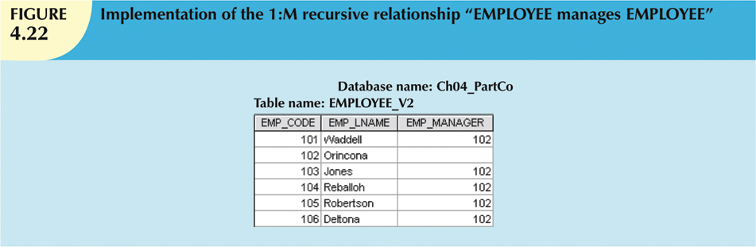
An Employee has one manager.
A manager may manage one or more employees.
A manager is also an employee
EMP_CODE is PK, EMP_MANAGER is an FK but references the PK of the same table!

Slide 30
Associative (Composite) Entities
Also known as bridge entities
Used to implement M:N relationships
Composed of primary keys of each of the entities to be connected
May also contain additional attributes that play no role in connective process

Slide 31

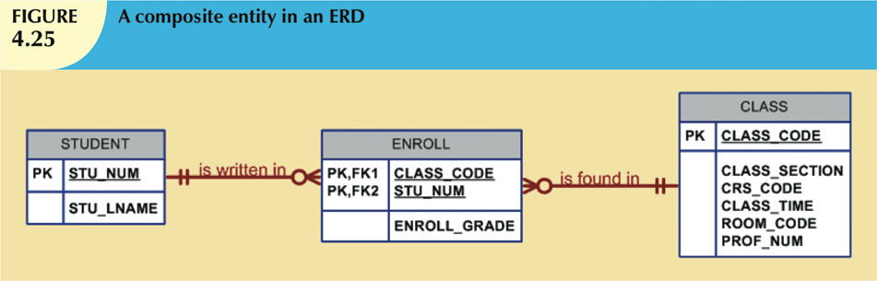
Many to Many
Conversion to One to Many

Slide 32
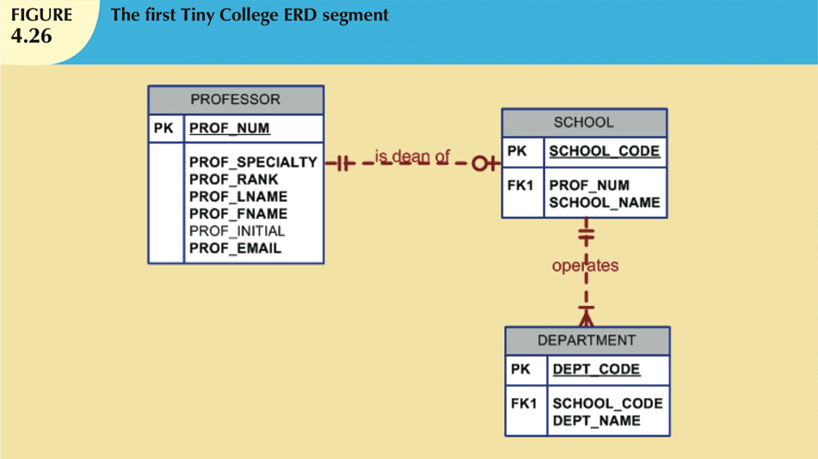
O refers to Optionality
Please refer to the text for a fuller discussion of this and the following diagrams

Slide 33
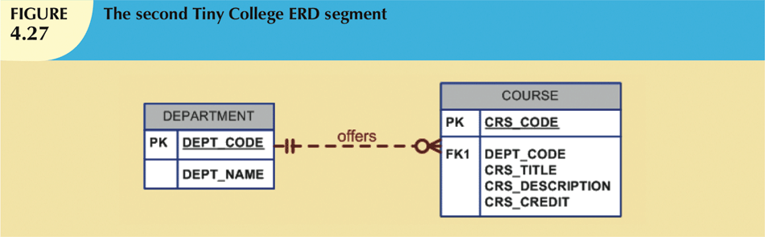
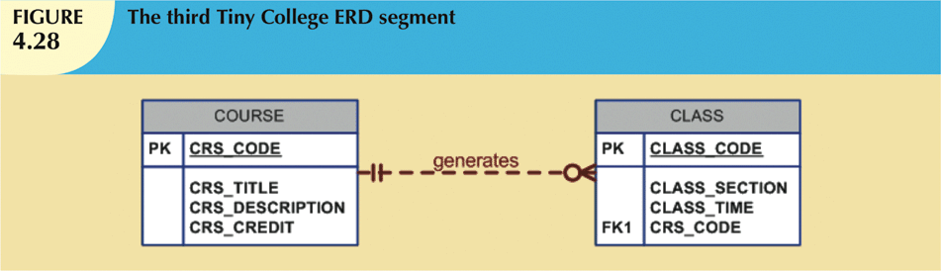

Slide 34
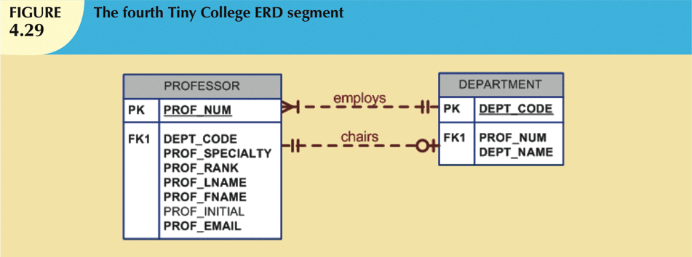

Slide 35
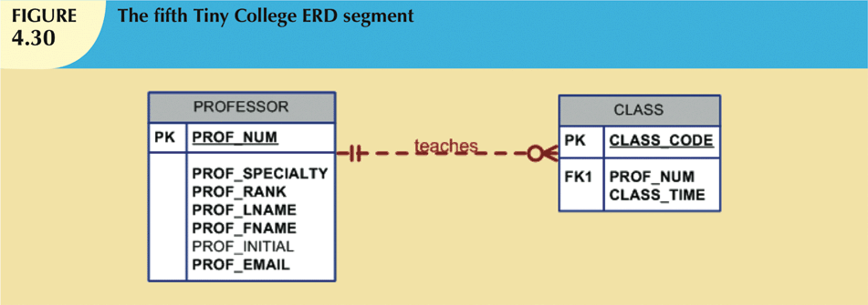

Slide 36
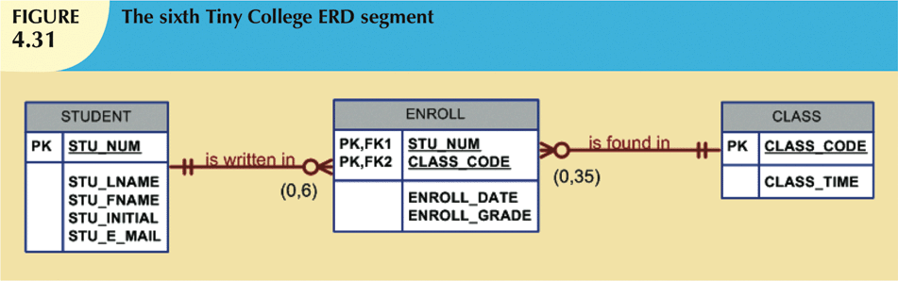

Slide 37
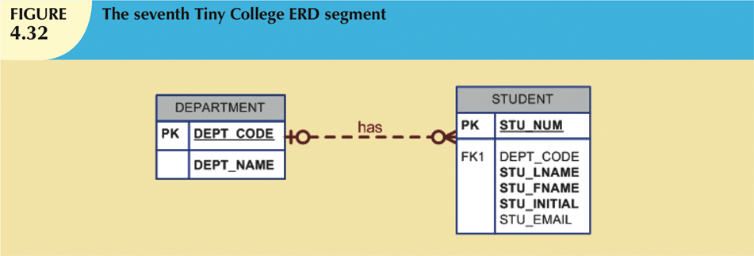
A student may not yet be assigned to a department – hence the O on the department side. A department may exist but no students have yet been registered – hence the O on the student side

Slide 38
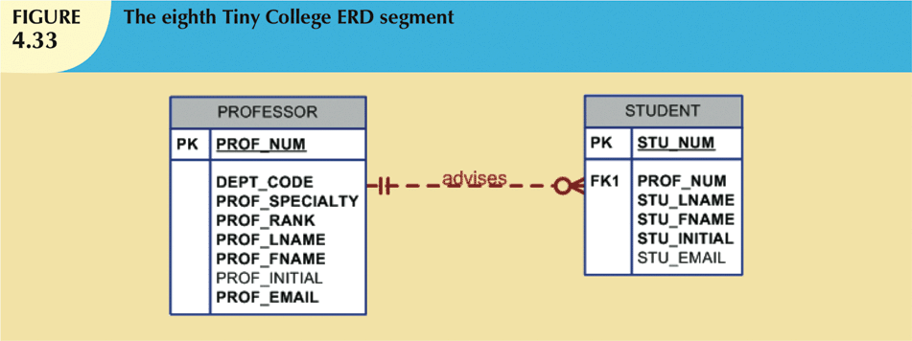

Slide 39
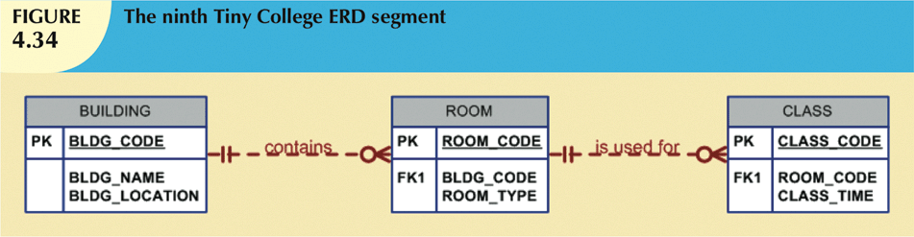

Slide 40
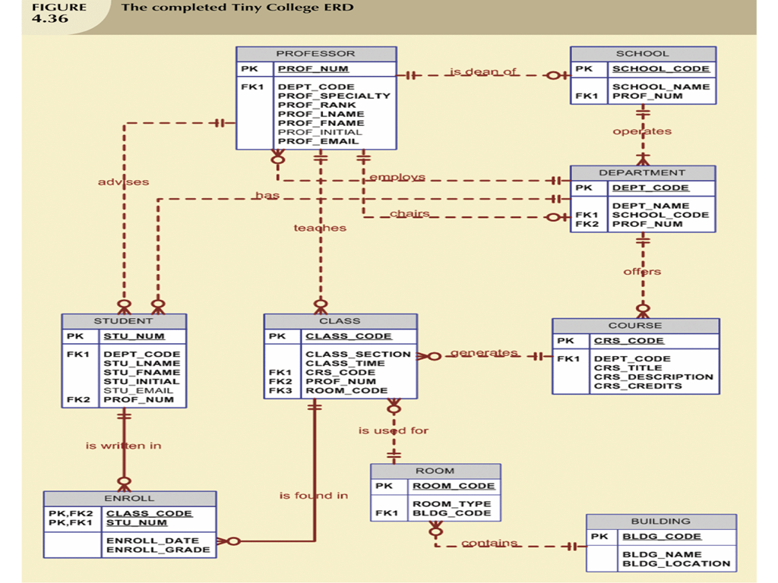

Slide 41
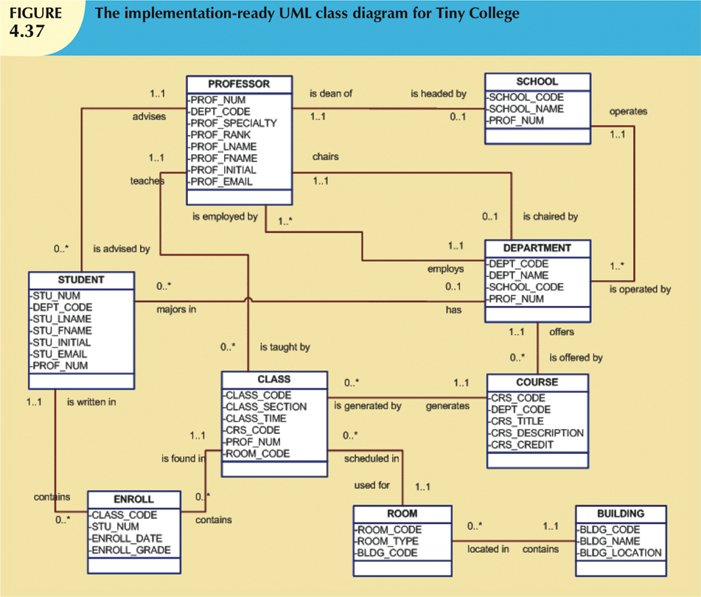

Slide 42
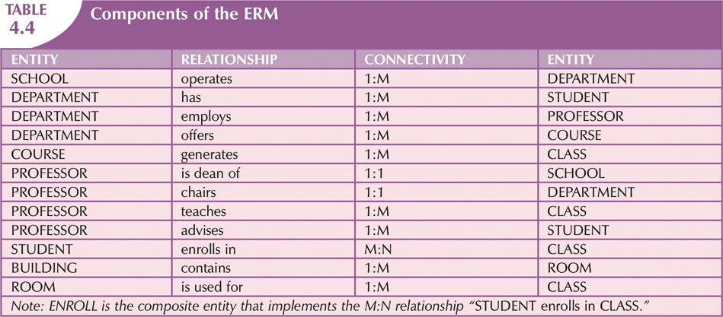

Slide 43
Summary: Developing an ER Diagram
Database design is an iterative process
Identify business rules based on description of operations
Identify main entities and relationships from business rules
Develop initial ERD
Identify attributes and primary keys that adequately describe entities
Revise and review ERD

